Slide 1
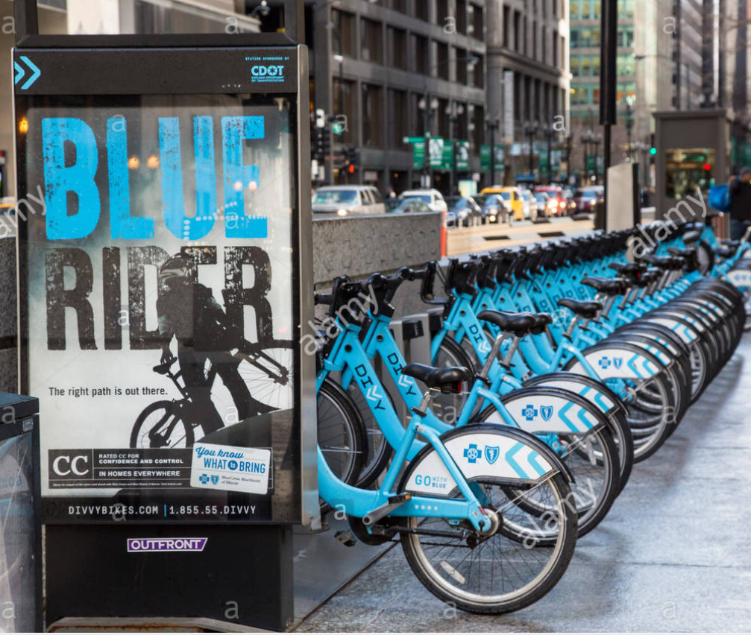
Problem Statement
Predicting which station needs more docks based on the traffic ( to and fro) at the station. This is also by keeping in mind the revenue generated v/s the cost required to build more docks
Description: The purpose of this problem statement to identify which stations needs more docks

Slide 2
Data Cleaning

Slide 3
Data Cleaning
Column Names of 2 quarters data not aligned with remaining quarter data set
Calculating revenue based on trip duration
Identifying missing percentage of each columns values and removing those rows where missing percentage was less than 10%
Converting timestamp variables into datetime data type from object data type
Calculating distance travelled using lat long of origin and destination points
Loreum Ipsum
Converting the trip duration variable from string to float
Loreum Ipsum

Slide 4
Exploratory Data Analysis - Graphs

Slide 5
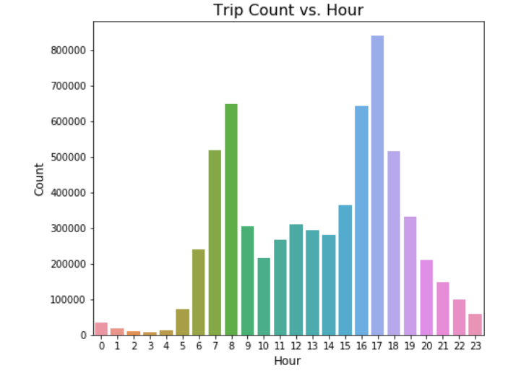
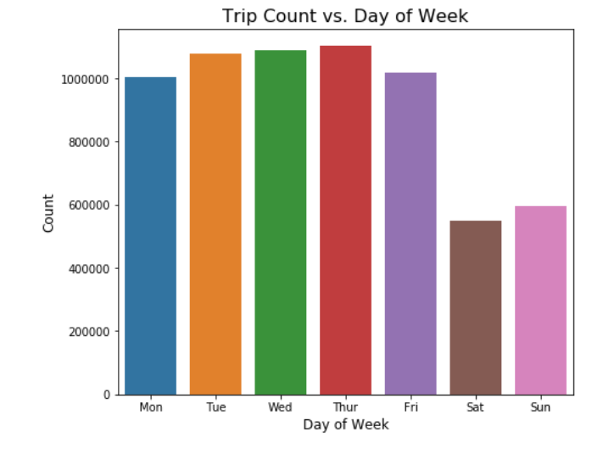
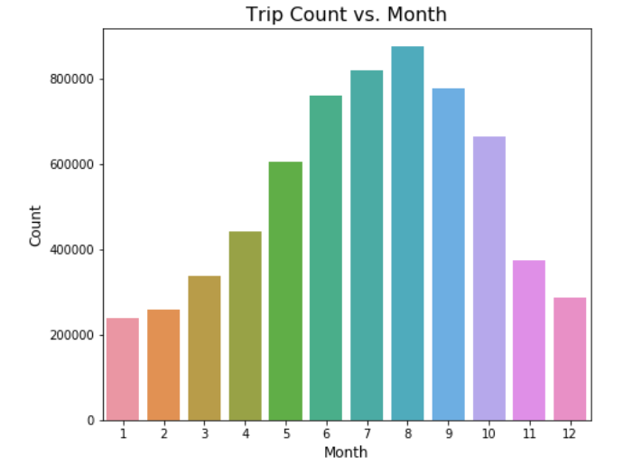
EDA – Part 2
It is quite evident that usage of Divvy rental bikes increases during Summer which is quite obvious as Chicago being cold place people prefer to use rental bike when temperature is pleasant
Similarly, on weekends people are less likely to use Bike service in comparison to weekdays which can be observed from the histogram
Analyzing the hourly breakdown it can be observed bike usage peaks in the morning and evening time which can be associated to working hours of most of the people

Slide 6
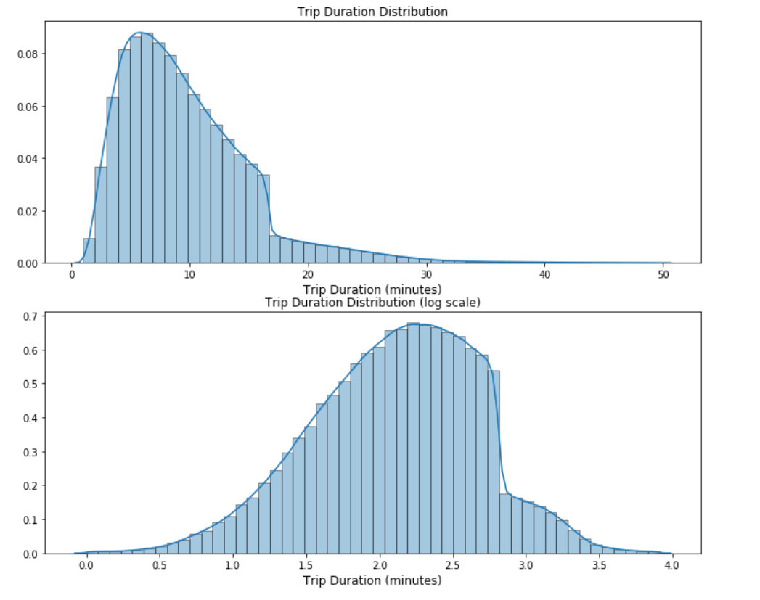
EDA – Part 3
Trip Duration distribution shows that most of the trips ranges from 5 minutes to 10 minutes

Slide 7
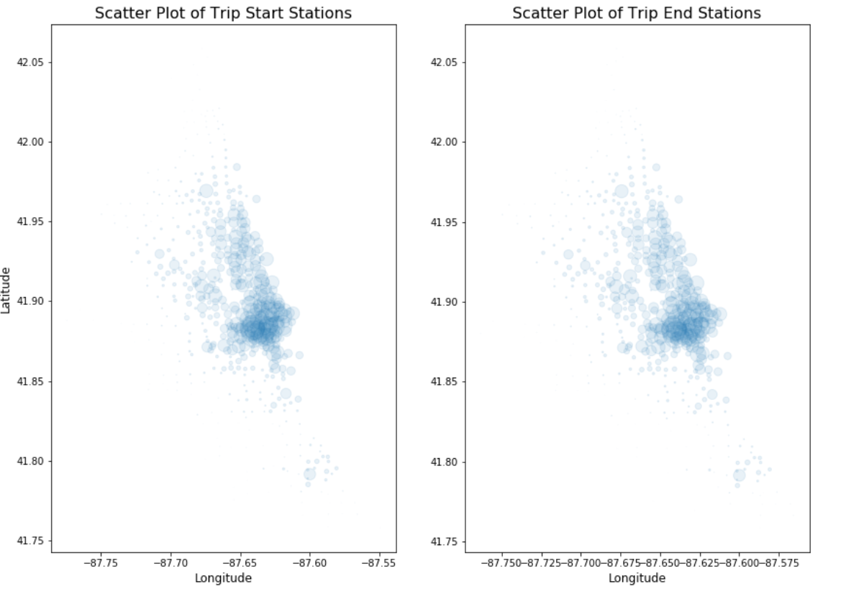
EDA – Part 4
Analyzing the scatter plot of Start Stations and End Stations it can be observed that most of the trips happens in the central Chicago and very less customer take Divvy bike in South side of Chicago which makes it potential place to advertise Divvy service in that region

Slide 8
Machine Learning Model

Slide 9
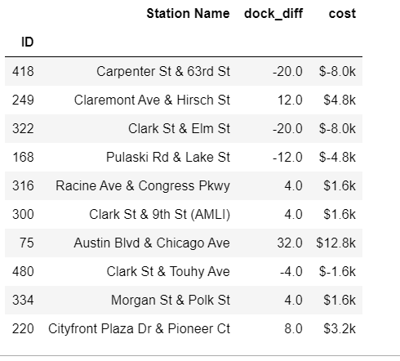
Model 1 knn Classification
Applying knn Mode Classification to predict required number of docks based on predictor variables a. tripduration b. to_station_id c. to_longitude d. from_longitude d. revenue identified using correlation matrix.
Obtained output was used to compare it with existing docks and the difference was used to identify which station need extra docks or which one has extra docks. Costing was calculated assuming each dock setup requires $400
Conclusion: Assuming $400 for each dock using knn Model Classification it is estimated that Divvy can save $ 3M if setup dock as per prediction made by this model
There are 281 docks which require extra docks and if implemented can serve to customer in better way

Slide 10
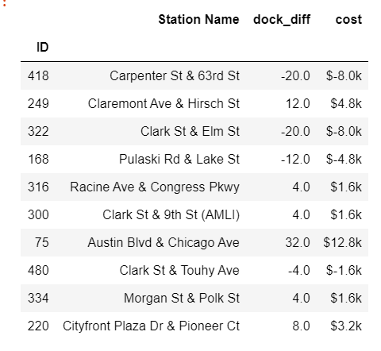
Logistic Regression
Applying logistic to predict required number of docks based on predictor variables a. tripduration b. to_station_id c. to_longitude d. from_longitude d. revenue identified using correlation matrix.
Obtained output was used to compare it with existing docks and the difference was used to identify which station need extra docks or which one has extra docks. Costing was calculated assuming each dock setup requires $400
Conclusion: Assuming $400 for each dock using logistic regression, it is estimated that Divvy can save $ 46,800 if setup dock as per prediction made by this model
There are 281 docks which require extra docks and if implemented can serve to customer in better way

Slide 11
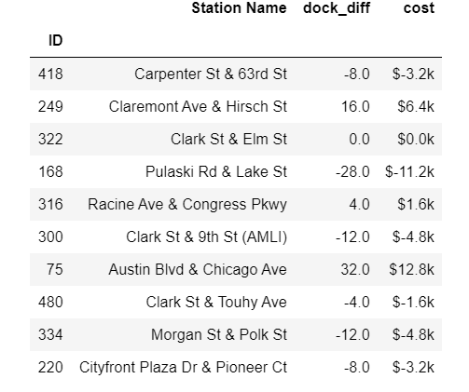
Naïve Bayes Classification
Applying NB Classification to predict required number of docks based on predictor variables a. tripduration b. to_station_id c. to_longitude d. from_longitude d. revenue identified using correlation matrix.
Obtained output was used to compare it with existing docks and the difference was used to identify which station need extra docks or which one has extra docks. Costing was calculated assuming each dock setup requires $400
Conclusion: Assuming $400 for each dock using logistic regression, it is estimated that Divvy can save $ 5,28,400 if setup dock as per prediction made by this model
There are 287 docks which require extra docks and if implemented can serve to customer in better way

Slide 12
Conclusion
We established significant relationship between several independent variables and Bikesharing ridership.
Out of three ML algorithms applied it can be observed that knn Classification gives the best result. Majority of stations that needed upgrade in docks number are in Central Chicago where most probably daily office goers must be using divvy. Whereas stations that needs to cut short on number of docks are also identified which can be used to save money and use them for stations where there is need to increase docks.

